Slide 1
Business Model Canvas

Slide 2
Business model canvas is a visual template that helps entrepreneurs document an existing business model or develop a new one. Alexander Osterwalder created it in 2005, based on his academic work on business model ontology.
The business model canvas was designed with startups in mind. It quickly became an alternative to the traditional business plan which wasn’t agile enough to accommodate newly emerging companies.
The revolutionary thing about the business model canvas was that it allowed entrepreneurs to capture a business model on a single page. This made business planning simpler and more structured.

Slide 3
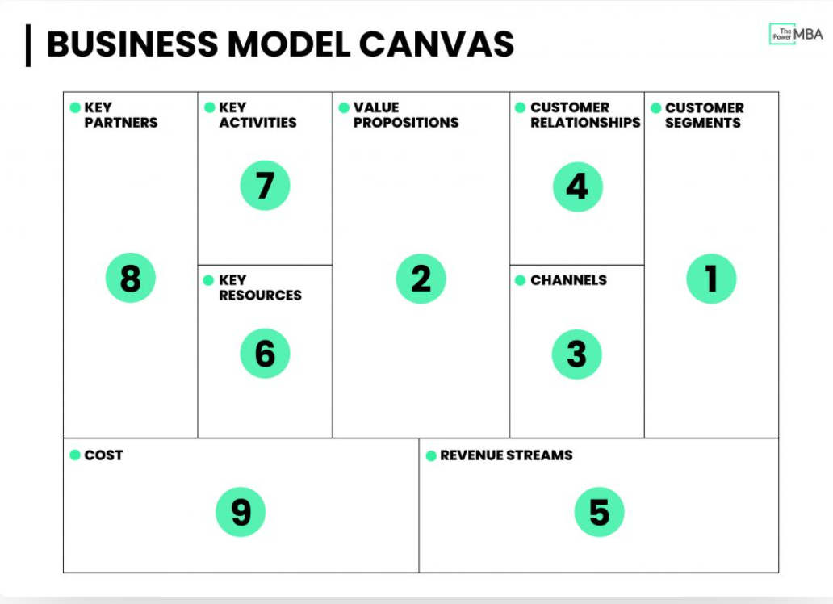
Notes:
The business model canvas allows us to carry out a high-level analysis without drilling down and getting lost in the details.

Slide 4
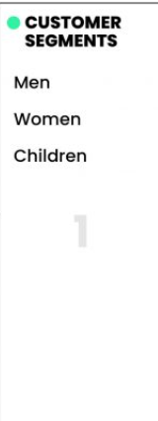
Fashion retail giant Zara
The first block of the Business Canvas Model is about understanding who is the most important customer(s) you’re delivering value to. Or, in other words, who are they? What do they do? And why would they buy your product or service?
Buyer personas are fictional depictions of an ideal or hypothetical client. Typically when brainstorming a buyer persona you’d want to define certain characteristics (age, demographic, gender, income, industry, pain points, goals, etc.)

Slide 5
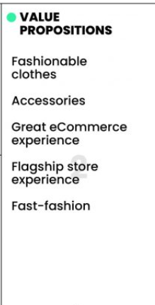
The second phase is about figuring out your company’s value propositions, and importantly, your UVP (unique value proposition). The “what” that makes customers turn to you, over your competitors? Which of their problems are you best at solving?
Zara’s principal value propositions are fairly clear. They offer various ranges of stylish men’s, women’s, and children’s clothing and accessories at an affordable price.
Notes:
Zara demonstrates its aesthetic evolution to customers through its flagship stores. The recent opening of their Hudson Yards, New York City flagship is a great example of this.

Slide 6
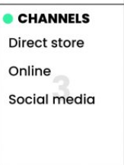
The next step is to ask yourself how you are reaching your customers, and through which channels?
This includes both the channels that customers want to communicate with you as well as how they’ll receive your products or services.
Is it going to be a physical channel? (store, field sales representatives, etc.) Or is it a digital channel? (mobile, web, cloud, etc.).

Slide 7
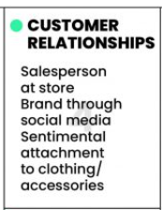
Once you have acquired customers, you will need to think about how you can build, nurture, and grow those relationships.
Zara’s relationship with its customers is threefold, and lies somewhere in the middle of transactional and personal:
Salesperson at store
Brand through social media
Sentimental attachment to a product

Slide 8
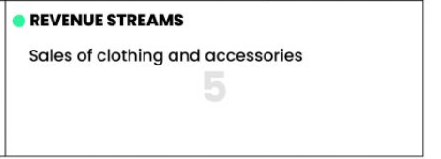
Now that you’ve described how you are going to create real value for your customers, it’s time to look at how you plan to capture that value.
At Zara, it’s extremely simple. They make their money by selling clothes and accessories either at a store or online.

Slide 9
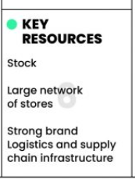
Now it’s time to move over to the left side of the business canvas model and look at what we need, internally, to deliver our value propositions.
The key resources are all things you need to have, or the assets required to create that value for customers.
This could be anything from intellectual property (patents, trademarks, copyrights, etc.) to physical holdings (factories, offices, delivery vans, etc.) right down to finances (the initial cash flow perhaps needed to start your brand)

Slide 10
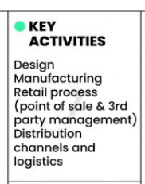
The next step is to define the key activities – the areas you need to be good at to create value for your customers.

Slide 11
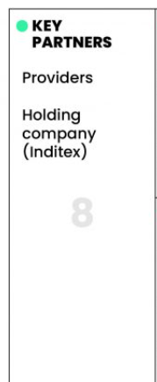
Most modern business models now require brands to build out and work with various key partners to fully leverage their business model.
This includes partnerships such as joint ventures and non-equity strategic alliances as well as typical relationships with buyers, suppliers, and producers.
Zara requires strategic partnerships with many different providers if they are to design and produce their collections.
Another key partner is their major holding company, Inditex.

Slide 12
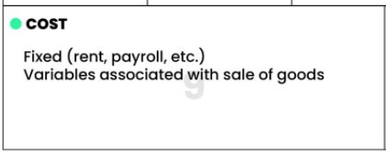
The final step of the Business Model Canvas is to ask yourself, how much is it going to cost to run this model?
This includes some of the more obvious needs such as manufacturing costs, physical space, rent, payroll, but also areas such as marketing activities.

Slide 13
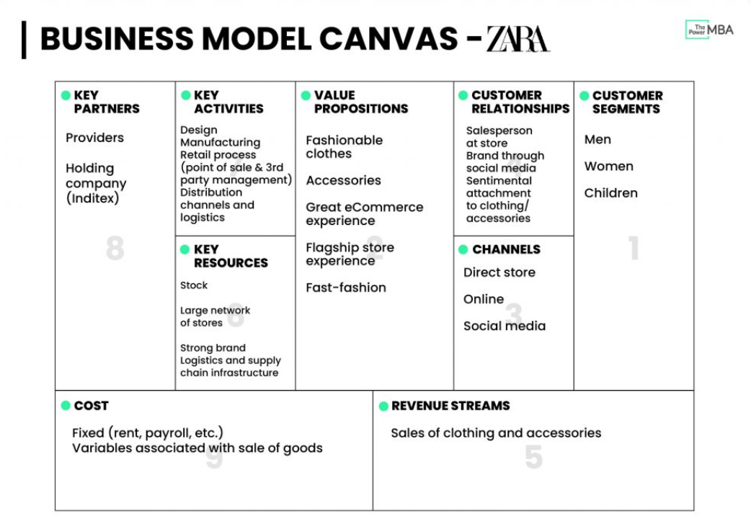

Slide 14
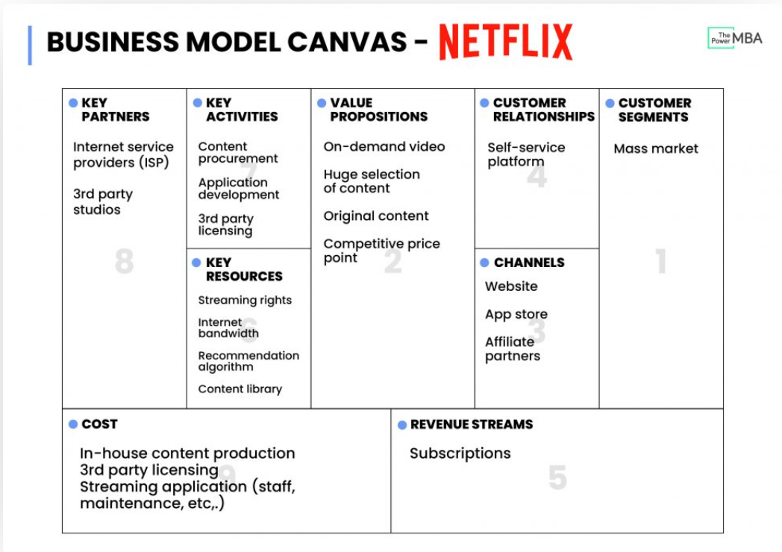

Slide 15
Advantages of the business model canvas:
Defines key activities that generate value and revenue for the business.
Encourages strategic relationships with clients and partners.
Enables testing of an existing business model against the market.
Disadvantages of the business model canvas:
It doesn’t accommodate businesses in very early stages of development.
Enables risky assumptions within the business model, without offering a clear way to verify them.
Focuses on the end-shape of the business without defining the strategy to get there.

Slide 16
Both lean and business model canvas are visual representations of the reality in which your business operates. But, unlike the traditional business plan, they are sketches. You need to update them as you grow your business and learn.
The lean and business model canvas allows you to capture your business model on a single page. The main difference between them is that lean canvas zeroes in on solving a problem. Meanwhile, the business model canvas centers around selling a specific product.
The lean canvas is a variation of the business model canvas for lean startups. It was created by Ash Maurya who became concerned with risky assumptions enabled by the business model canvas.
Lean canvas is a simpler approach, focusing on solving one problem at a time. It can be used even when you’re starting from scratch and helps you brainstorm solutions. It’s a good way to start if you want to identify a problem first - and derive your product from that.

Slide 17
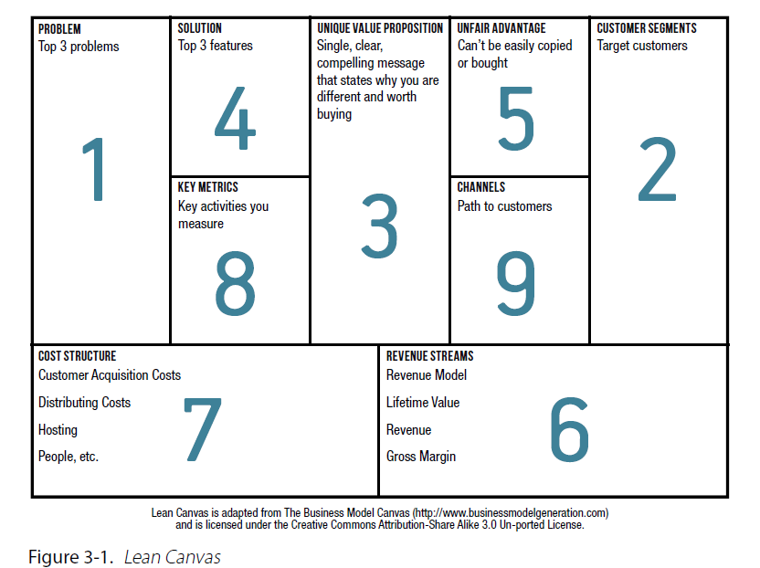
Lean Canvas

Slide 18
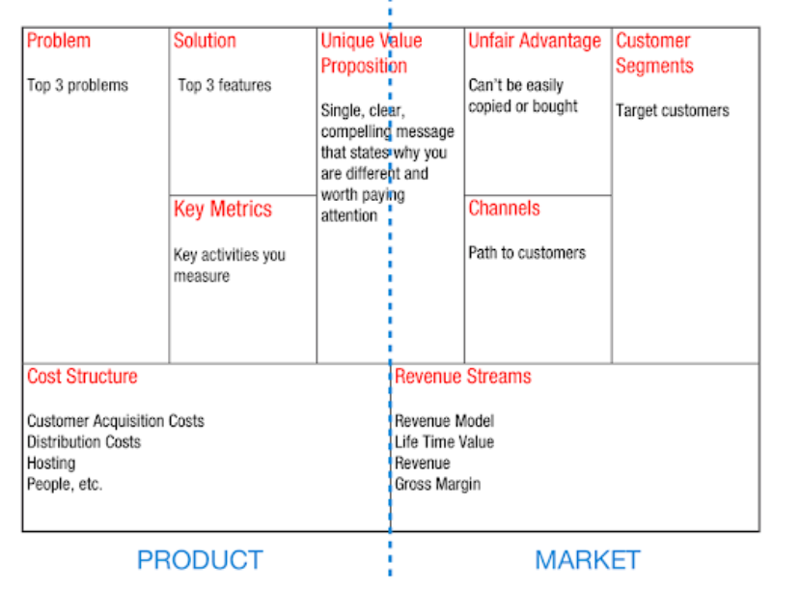
Lean Canvas

Slide 19
The 9 elements of the lean canvas, with examples from the Uber London
Problem, e.g. difficult to find a cab when you need it
Solution, e.g. guaranteed fast pick-up from your location
Key metrics, e.g. apps installed, journeys booked
Unique value proposition, e.g. taxi service, but cheaper, easier and safer
Unfair advantage, e.g. high brand awareness
Channels, e.g. friend referrals
Customer segments, e.g. young, internet-savvy Londoners and tourists
Cost structure, e.g. marketing, PR
Revenue streams, e.g. 25% of fare based on route and idle time.

Slide 20
Advantages of the lean canvas
It focuses on understanding the problem that the business is trying to solve.
Restrains the “solutions” box, encouraging simple and easily testable ideas.
Proposes key metrics to evaluate whether the business is moving in the right direction.
Accounts for uncertain conditions, assumptions, and incomplete data.
Disadvantages of the lean canvas
Overemphasizes the internal focus without accounting for the surrounding ecosystem.
Lacks the “Resources” box which may lead to unrealistic product ideas.

Slide 21
The differences between lean canvas vs business model canvas
Adding the “Problem” and removing the “Key Partners” box
Charles Kettering once said that “a problem well stated is a problem half-solved.” Ash Maurya also believes that identifying the problem should be the starting point for any business.
Many startups fail not because they can’t deliver the product, but because they misunderstand the problem they’re solving. The lean canvas makes sure the problem identification is a crucial step in the process.
Meanwhile, Maurya decided to take out the “Key partners” box. Even though he recognizes the need to create business partnerships, he says that “when you are an unknown startup with an untested product, pursuing key partnerships from day one can be a form of waste.”
With the lean approach, looking for partners comes later. The first concern is understanding the problem.

Slide 22
Adding the “Solutions” and removing the “Key Activities” box
The “Solutions” box in the lean canvas is small on purpose. This is aligned with the lean startup approach to MVP: developing a simple solution and checking if it works.
Incorporating “Solutions” (in plural!) in the lean canvas prevents entrepreneurs from blindly following their first idea. Having it as a part of the lean canvas makes it subject to verification - just like any other part of the business model.
At the same time, the “Key Activities” box from the original business model canvas was removed. That’s because key activities should derive from the “Solutions,” after they have been tested and validated through the MVP.

Slide 23
“Key metrics” instead of “Key Resources”
Key metrics were introduced to the lean canvas to give business owners a way to tell whether they’re on the right track.
Initially, startups may be drowning in all kinds of data and numbers. It’s important to discern which of them are important and indicative of growth. Using the wrong (or too many) metrics as signs of growth can lead to enormous waste.
Noah Kagan even said: “A startup can only focus on one metric. So you have to decide what that is and ignore everything else.”
Why were the “Key Resources” removed? Ash Maurya argues that in the digital age, new-product development isn’t as resource-demanding as it used to be. On top, some of the key resources can also fall into the “unfair advantage” box.
Notes:
Discern :to see or notice something with difficulty

Slide 24
“Unfair advantage” instead of “Customer Relationships”
An unfair advantage in business is the shield against copycats and plagiarism. It’s the part of the business model that’s so unique and contextual that it’s extremely hard to replicate.
When Ash Maurya added this box to the lean canvas, he was aware that few startups find their unfair advantage straight away. On day one, this box can be blank. But over time, it should inspire business owners to look for their unfair advantage that makes their solutions hard to copy.
This box took the place of “Customer Relationships” in the business model canvas. That’s because startups don’t usually strategize their first relationships with clients. Rather, raw interactions emerge through customer interviews, product tests, and feedback.

Slide 25
Types of Business Model
Aspect | B2B Business Model | B2C Business Model
Definition | – B2B businesses sell products or services to other businesses or organizations. – Transactions are typically larger in scale and involve contracts and negotiations. | – B2C businesses sell products or services directly to individual consumers. – Transactions are often smaller and focus on individual customer needs.
Target Audience | – B2B businesses target other businesses, institutions, or organizations as their customers. | – B2C businesses target individual consumers as their customers.
Purchase Decision Process | – B2B purchases often involve a more complex decision-making process, with multiple stakeholders and a longer sales cycle. – Decision criteria may include cost savings, efficiency, scalability, and ROI. | – B2C purchases tend to have a shorter decision-making process, with individuals making purchasing decisions based on personal preferences, emotions, and immediate needs.
Sales Approach | – B2B sales typically involve direct sales representatives, account managers, and relationship-building. – Sales efforts focus on building long-term partnerships. | – B2C sales may use various channels, including e-commerce websites, retail stores, advertising, and promotions. – Sales efforts focus on brand awareness and consumer loyalty.
Marketing Strategies | – B2B marketing often involves targeted campaigns, industry-specific content, and trade shows or conferences. – Content focuses on educating and addressing the unique needs of businesses. | – B2C marketing utilizes mass advertising, social media, influencer marketing, and promotions. – Content focuses on emotional appeal and consumer benefits.

Slide 26
Aspect | B2B Business Model | B2C Business Model
Product/Service Complexity | – B2B products or services may be more complex, specialized, and customized to meet the specific needs of businesses. | – B2C products or services are often designed for simplicity and mass appeal.
Customer Relationship | – B2B relationships tend to be long-term, built on trust and ongoing support. – Customer feedback and customization are common. | – B2C relationships may be shorter-term and transactional, with less ongoing interaction.
Key Differences | – B2B transactions are often based on contracts and long-term agreements. – Sales cycles are longer. – B2B marketing focuses on educating and addressing business needs. | – B2C transactions are typically individual purchases with no long-term commitments. – Sales cycles are shorter. – B2C marketing emphasizes emotional appeal and consumer benefits.
When to Use Each Model | – Use a B2B model when your product or service is tailored to the needs of other businesses or organizations. – Ideal for complex or specialized solutions. | – Use a B2C model when your product or service is designed for individual consumers. – Suitable for products with mass appeal.

Slide 27
B2B (Business-to-Business) Examples:
Cisco Systems: They provide networking hardware and software solutions primarily to other businesses.
Slack: While individuals can use Slack for personal reasons, it’s primarily a collaboration tool for teams and businesses.
Adobe’s Creative Cloud for Enterprises: Adobe offers special enterprise-level packages of its Creative Cloud software suite tailored for business needs.
Dropbox Business: While Dropbox offers personal cloud storage solutions, its business variant provides enhanced storage and collaboration tools for companies.
Mailchimp: Primarily used by businesses for email marketing campaigns and automations.
LinkedIn’s Marketing Solutions: LinkedIn offers advertisement and marketing solutions specifically targeting professionals and other businesses.
Boeing: They primarily sell airplanes to airlines and governments, not to individual consumers.

Slide 28
B2C (Business-to-Consumer) Examples:
Netflix: Directly provides streaming services to individual subscribers.
Coca-Cola: While they do sell to distributors and retailers, their primary focus is on the end consumer who drinks their beverage.
Nike: They design and sell footwear, apparel, and equipment directly to consumers, though they also have B2B operations.
Apple’s iTunes: While Apple has B2B components, iTunes primarily sells songs and movies to individual consumers.
Amazon Prime: The subscription service offers individuals a range of benefits from fast shipping to streaming, although Amazon also has B2B operations.
McDonald’s: They primarily serve food directly to individual consumers, though there’s a B2B component in sourcing ingredients and franchise operations.
Spotify: Provides music streaming services directly to individual user

Slide 29
Types of business models and examples
1. Retailer model
A retailer is the last link in the supply chain. These businesses purchase goods from manufacturers or distributors and then sell them to customers for a price that will both cover expenses and turn a profit. Retailers may specialize in a particular niche or carry a range of products.
Examples: Many of the businesses you patronize day to day are probably retailers, from grocery stores to pharmacies to florists.
2. Manufacturer model
A manufacturer converts raw materials into products. Then, they sell those products to distributors, retailers or directly to consumers.
Example: Manufacturing businesses build everything from furniture to pharmaceuticals. They can be companies of any size and in almost any industry.
3. Fee-for-service model
A business charges a set fee for a specific service. A business set up on this model can increase its earnings by doing work for additional clients or by raising its rate
Example: Hairstylists, accountants and real estate agents all charge fees for their specialized services. They may work independently or be affiliated with their shops/organization.

Slide 30
4. Subscription model
Essentially, the customer makes a recurring payment for ongoing access to a service or product. A company may directly ship its product in the mail, or you may pay a fee to use its services.
Example: Many local farms offer farm shares or community-supported agriculture subscriptions, where clients get access to fresh produce on an ongoing basis while crops are in season.
5. Bundling model
The bundling business model involves companies selling two or more products together as a single unit, often for a lower price than they would charge selling the products separately.
Example: Many class-based fitness centers and gyms use a type of bundling model, where clients pay fees for a certain number of classes per month. The more classes a client buys, the cheaper each individual class becomes, even though their total spend increases.
6. Product-as-a-service model
Product-as-a-service businesses charge customers to use physical products. They may charge a subscription fee, a per-use or per-mile fee, or a combination of both.
Example: Bike rental companies offer products as a service. Customers might pay an annual membership fee plus a per-mile fee each time they ride, or they might have the option to rent a bike for the day.
7. Leasing model
Under a leasing business model, a company buys a product from a seller. That company then allows another company to use the product they purchased for a recurring fee. Leases usually have longer terms — days or weeks compared to minutes or hours.
Example: A business that rents machinery like backhoes, augers and dozers to individuals for their home construction projects is using a leasing business model.

Slide 31
8. Franchise model
A franchise is an established business blueprint that a franchisee purchases and reproduces. The franchiser, or original owner, works with the franchisee to help them with financing, marketing and other business operations to ensure the business functions as it should. In return, the franchisee pays the franchiser a percentage of the profits.
Example: Domino’s,
9. Distribution model
A company operating as a distributor is responsible for taking manufactured goods to the market. To make a profit, distributors buy the product in bulk and sell it to retailers at a higher price.
Example: A chain of beauty salons that buys supplies in bulk and sells some of them to other salons is using a distribution business model
10. Freemium model
In a freemium model, customers can use parts of a product or service for free but must pay for access to more advanced features. This model is common in the software-as-a-service space — Spotify, for instance, has a free ad-supported tier, but subscribers get to listen ad-free.
Example: Some news and internet publishing companies use a freemium model, where some or all content is free but premium content or special features are paywalled.
11. Advertising or affiliate marketing model
With advertising, a business sell its audience’s attention. Advertisers pay for space — whether it’s in the pages of a magazine or on the side of a vehicle — with rates usually determined by the size of the business's audience.
Example: A fashion blogger who sells ads on their podcast or website is using an advertising model.

Slide 32
Diversifications in B2B Business Models
As you might have imagined, a model as complex as B2B ought to be divided into several categories. They are divided into 3 types basically.
A) Supplier Centric Model
Supplier-centric models form the type of business where a supplier sets up a marketplace and intends to sell his customized solutions to various businesses. Most of them price their solutions according to the needs of the client/buyer.
B) Buyer Centric Model
This type of business model is most popular among the big corporates who involve in transactions with huge purchasing capacity and high volume purchases. The company here sets up a portal, mostly online to accept quotations from different sellers. The sellers then approach the company with their quotations and the company chooses to go with a seller that they deem profitable after thorough analysis.
C) Intermediary Centric Model
Intermediaries in the marketplace are the ones who provide a common platform for Buyers and Sellers to come together and interact, interactions in this sector can be in the form of transactions or plain communication. They maintain a database of buyers and sellers and their main goal is to profit from these associations.
B2B Business Model Example: Apple & Samsung

Slide 33
Diversifications in B2C Business Models
Reaching out to consumers and selling products to them is the primary goal of a B2C business model. To accomplish this, B2C has been divided into different categories based on the type of audience and the type of targeting used to reach them.
A) E-Retail or E-Tailing
E-Retailing has become the latest trend. Most consumers have an online presence these days and reaching them online is the cheapest and fastest mode. Businesses have realized this and have started setting up websites and marketing campaigns to reach and sell products to netizens.
B) Brick & Click Retail
You are all familiar with the typical brick and mortar shops, the kind where you walk in, select your goods, pay at the counter and take your goods.
Now, these businesses have realized the potential of the Internet and have started reaching out to a wider audience by setting up websites for their shops.
The best example of Brick and Click retail is TATA-owned electronic showroom chain Croma. They began with a brick-and-mortar shop which spread throughout the country garnering loyal customers for over a decade. Recently they started advertising their products through the croma.com website and now even have a dedicated online shopping portal called tatacliq.com
C) Virtual Malls
Visiting a mall is an experience in its own, you get overwhelmed with the abundant choices that they portray, always providing a fair level of competition to all businesses. Now imagine an online version of the same, that is the whole concept of Virtual Malls.
It is a website hosting several merchants, giving them a space on the web to showcase their products. The website owners charge a nominal fee from sellers to display and sell products.
These types of malls are better for businesses who want to market their Books, Music, Movies, Software or something along that line.

Slide 34
Running Lean offers a systematic process that allows startups to iterate from their initial plan (Plan A) to a plan that actually works, all while ensuring that resources are utilized effectively.

Slide 35
Step 1: Document Your Plan A
The first step is to document your initial vision. As entrepreneurs, we are most passionate about the solution box and what we are naturally good at; however, our job isn’t just building the best solution, but owning the entire business model and making all the pieces. This can be done using the Lean Canvas, a one-page business model diagram that is fast, concise, and portable, designed to be a quick and evolving document that captures the key elements of your business model.
Sketch your initial canvas in less than 15 minutes, leaving sections blank as needed. Think in the present and adopt a customer-centric approach.

Slide 36
What is Risk
Douglas Hubbard makes a clear distinction between the two in his book, How to Measure Anything (Wiley):
Uncertainty: The lack of compete certainty, that is, the existence of more than one possibility.
Risk: A state of uncertainty where some of the possibilities involve a loss, catastrophe, or other undesirable outcome.
The good news is that the Lean Canvas automatically captures uncertainties that also are risks—the loss here can be quantified both in terms of opportunity costs and real costs. But not all these risks are equal.
The way you quantify risk in your business model is by quantifying the probabilities of a specific outcome along with quantifying the associated loss if you’re wrong. This is a key step to prioritizing what’s riskiest on your
business model and determining where to start.

Slide 37
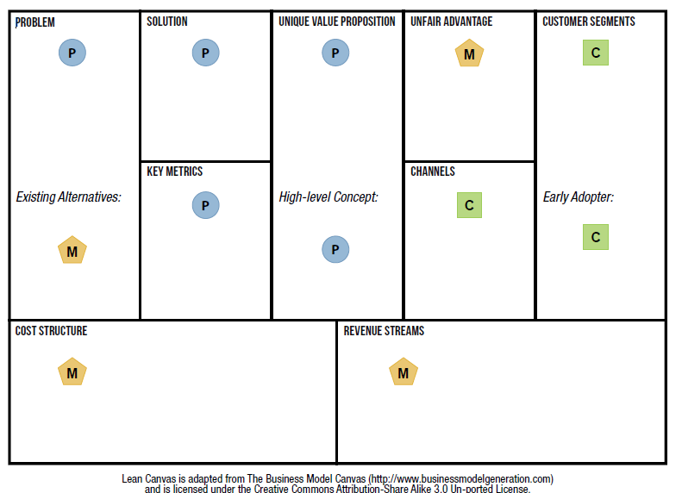
Risks in a startup can be divided into three general categories, listed here
and depicted in Figure
Product risk (P)
Getting the product right
Customer risk (C)
Building a path to customers
Market risk (M)
Building a viable business
Tackling all these risks at once can be overwhelming, which is why you need to prioritize them based on the stage of your product, and tackle them systematically

Slide 38
The different categories / types of risks faced by startups
Startups face various types of risks that can impact their success and sustainability. Understanding and managing these risks is crucial for the long-term viability of a startup. Here are different categories or types of risks faced by startups:
Market Risks:
Customer Acceptance: The risk that the target market may not accept or adopt the product or service as expected.
Competitive Landscape: Intense competition can impact market share and profitability.
Market Size and Growth: The market may be smaller than anticipated, or its growth may not meet expectations.
Financial Risks:
Cash Flow Issues: Insufficient cash flow can lead to operational challenges and even bankruptcy.
Budget Overruns: Exceeding planned expenditures can strain financial resources.
Funding Shortfalls: Difficulty in securing funding or investor interest.

Slide 39
The different categories / types of risks faced by startups
Operational Risks:
Supply Chain Disruptions: Issues with suppliers or logistics can disrupt operations.
Technology Failures: Technical glitches or failures can affect product/service delivery.
Human Resource Challenges: Employee turnover, lack of skilled personnel, or team conflicts.
Regulatory and Compliance Risks:
Legal Compliance: Failure to comply with regulations and laws can lead to fines or legal actions.
Policy Changes: Changes in government policies can impact the business environment.
Strategic Risks:
Execution Risks: Challenges in implementing business plans and strategies effectively.
Partnership Risks: Dependence on key partners or collaborations may face challenges.
Scalability Issues: Difficulty in scaling operations to meet demand.

Slide 40
The different categories / types of risks faced by startups
Reputation Risks:
Brand Damage: Negative publicity, customer dissatisfaction, or public perception issues.
Social Media Risks: Viral negative feedback on social media platforms.
Cybersecurity Risks:
Data Breaches: The risk of unauthorized access to sensitive information.
Hacking and Fraud: Security threats to digital assets and financial transactions.
Environmental and External Risks:
Economic Downturns: Economic fluctuations affecting consumer spending.
Natural Disasters: Environmental events disrupting operations.

Slide 41
The different categories / types of risks faced by startups
Intellectual Property Risks:
Infringement Issues: Legal challenges related to the infringement of patents or copyrights.
Lack of Protection: Failure to protect intellectual property adequately.
Pandemic and Global Risks:
Health Crises: Events such as pandemics impacting global operations.
Political Instability: Geopolitical events affecting international business.
Managing and mitigating these risks involves strategic planning, regular assessment, and agility in responding to changes in the business environment. Startups that proactively address these risks increase their chances of long-term success.

Slide 42
Seek External Advice
effective technique for further calibrating your risks is getting out of the building and validating them with people other than yourself.
It is imperative that you share your model with at least one other person.
An early advisor might be a prototypical customer, a potential investor, or another entrepreneur with specific expertise, domain knowledge, or experiential knowledge that applies to you.
Here are some guidelines for running business model interviews:
Devote 20% of your time to setup, 80% to conversation.
It’s found that leaving the complete canvas open in front of people always evokes a reaction because people can visualize the entire model and they always have an opinion.
Ask specific questions.
I specifically want to know:
– What do they consider to be the riskiest aspect of this plan? – Have they overcome similar risks? How? – How would they go about testing these risks? – Are there other people I should speak with?

Slide 43
Be wary of the “advisor paradox.”
Just as customer interviews aren’t about asking customers what they want, these interviews aren’t about asking advisors what to do.
The key is not to take this feedback as either “judgment” or “validation,” but rather as a means of identifying and prioritizing risk.
Recruit visionary advisors.
Much like early adopters want to help when you nail their problems, visionary advisors will want to help when you present them with interesting problems that trigger their strengths and passion.

Slide 44
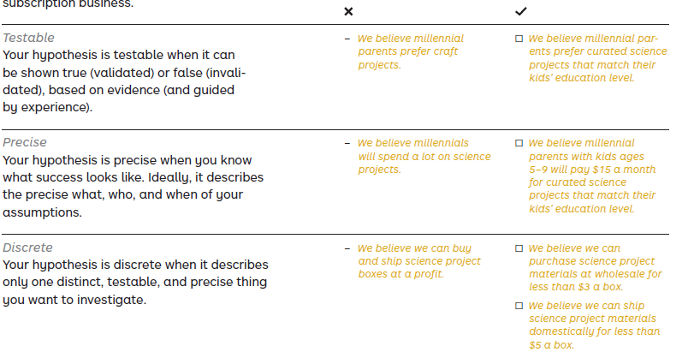
Hypothesis
For the purposes of Testing Business Ideas, we focus on your business hypothesis, which is defined as:
• an assumption that your value proposition, business model, or strategy builds on.
• what you need to learn about to understand if your business idea might work.
When creating hypotheses you believe to be true for your business idea, begin by writing the phrase “We believe that…”
Characteristics of a good hypothesis

Slide 45
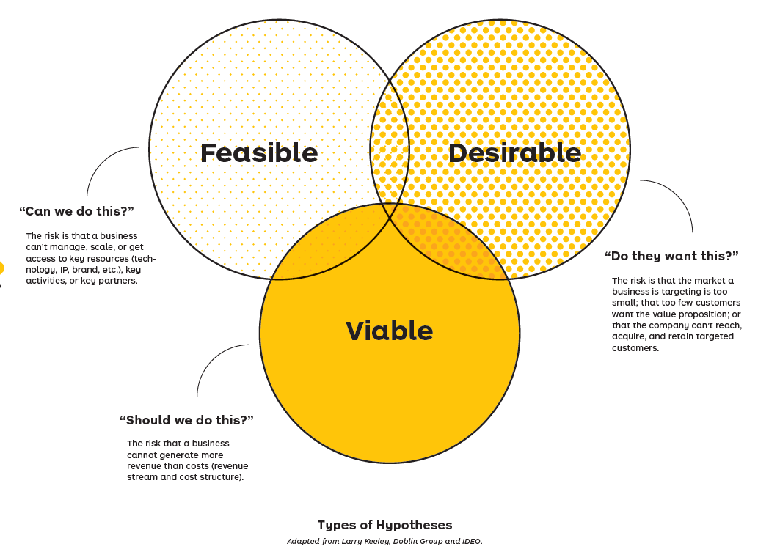

Slide 46
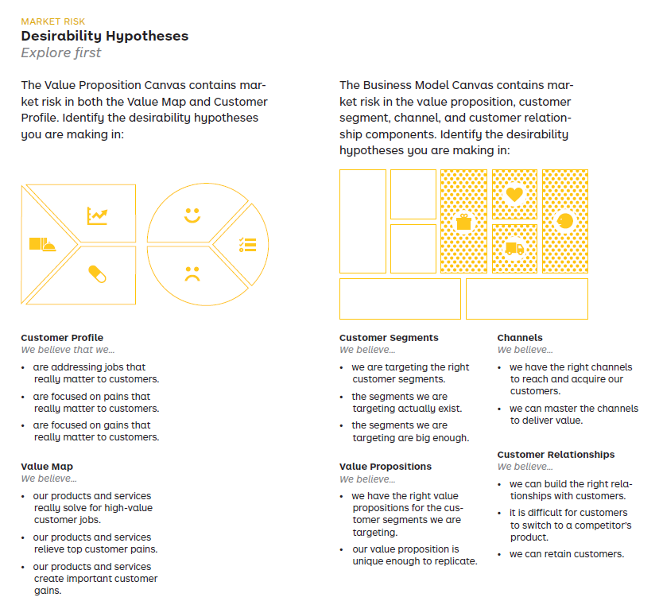

Slide 47
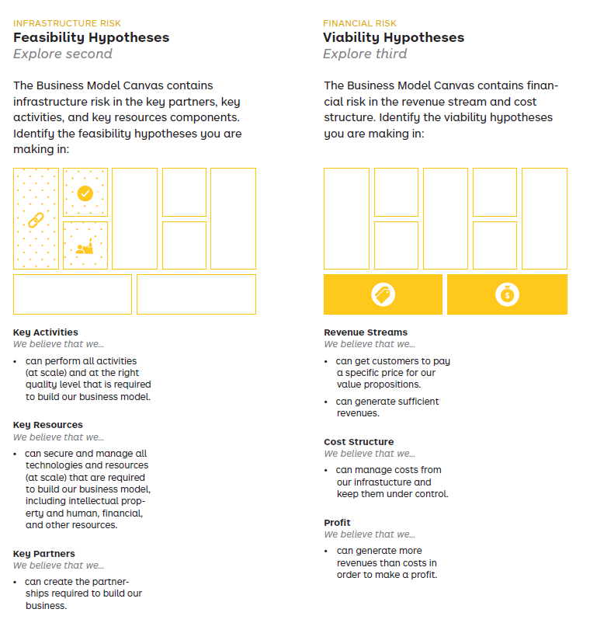

Slide 48
Assumption(Hypothesis) Mapping
A team exercise where desirability, viability, and feasibility hypotheses are made explicit and prioritized in
terms of importance and evidence.
Core team
The core team consists of individuals who are going to be dedicated to making this new business endeavor a success. They are cross-functional. This means they have product, design, and technology skills needed to ship and learn rapidly in the market with real customers. At a minimum, the core team needs to be present when mapping out the assumptions from your Business Model Canvas.
Supporting team
The supporting team consists of individuals who are not necessarily dedicated to the business endeavor but who are needed for it to be a success. People from legal, safety, compliance, marketing, and user research will be required for testing assumptions where the core team lacks the domain knowledge and know-how. Without a strong supporting team, the core members may lack evidence and make uninformed decisions about what’s important.

Slide 49
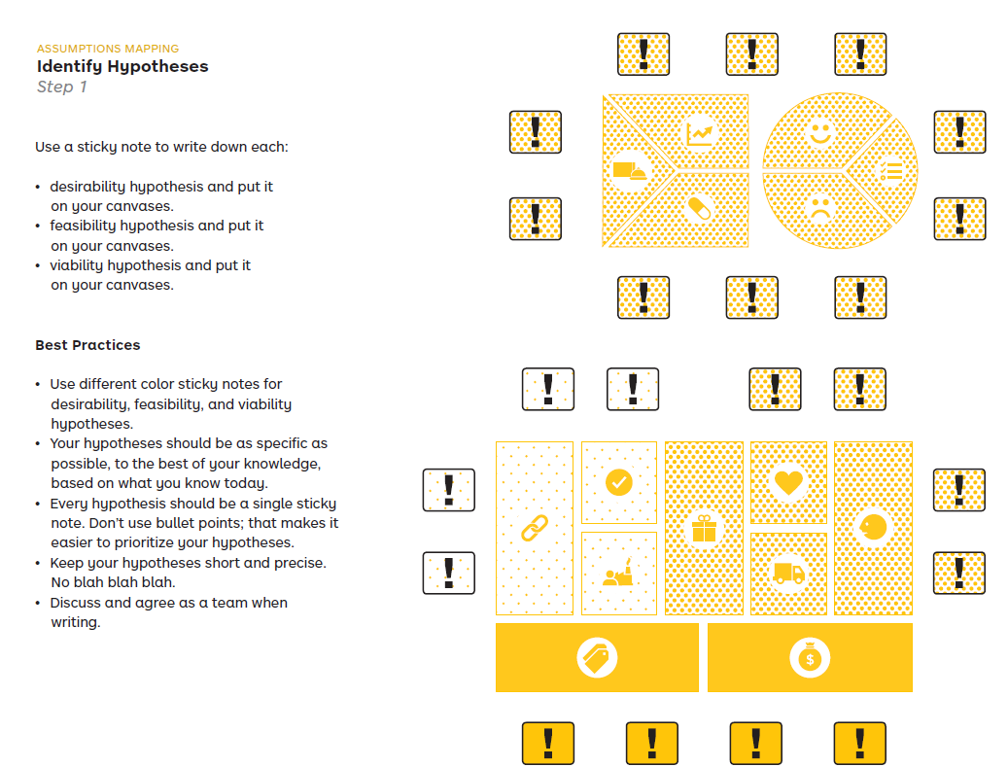

Slide 50
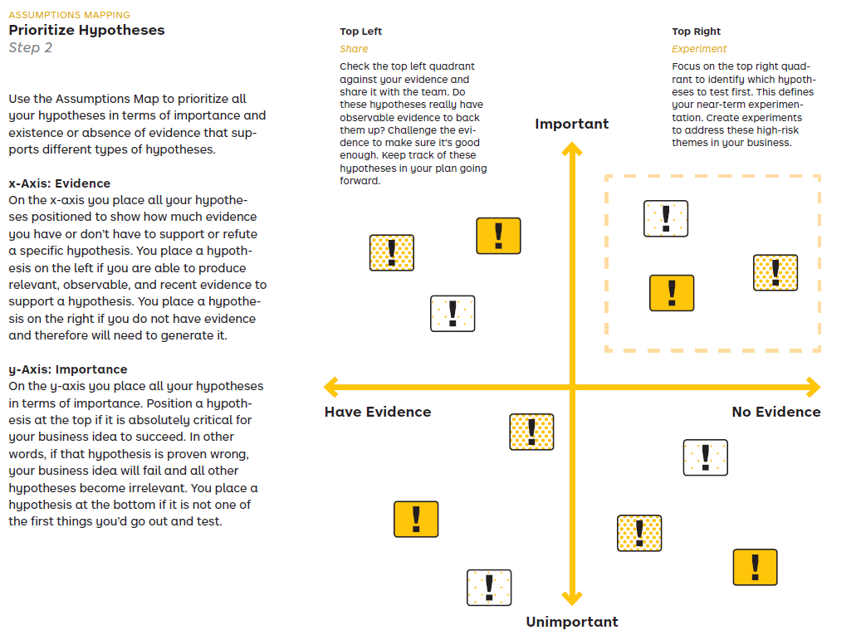

Slide 51
